Slide 1
Integrating Building Plans into a Campus Map
David Zubenko

Slide 2
Overview
This project looked at how building plans can be integrated into a campus map
Unfortunately many problems arose that prevented the project from being completed
This presentation will document what I was able to accomplish and how it can be used as a basis for future efforts

Slide 3
OPP Data
OPP provided .dwg (AutoCAD) files for Willard and Findlay buildings
This data can be brought into ArcMap

Slide 4
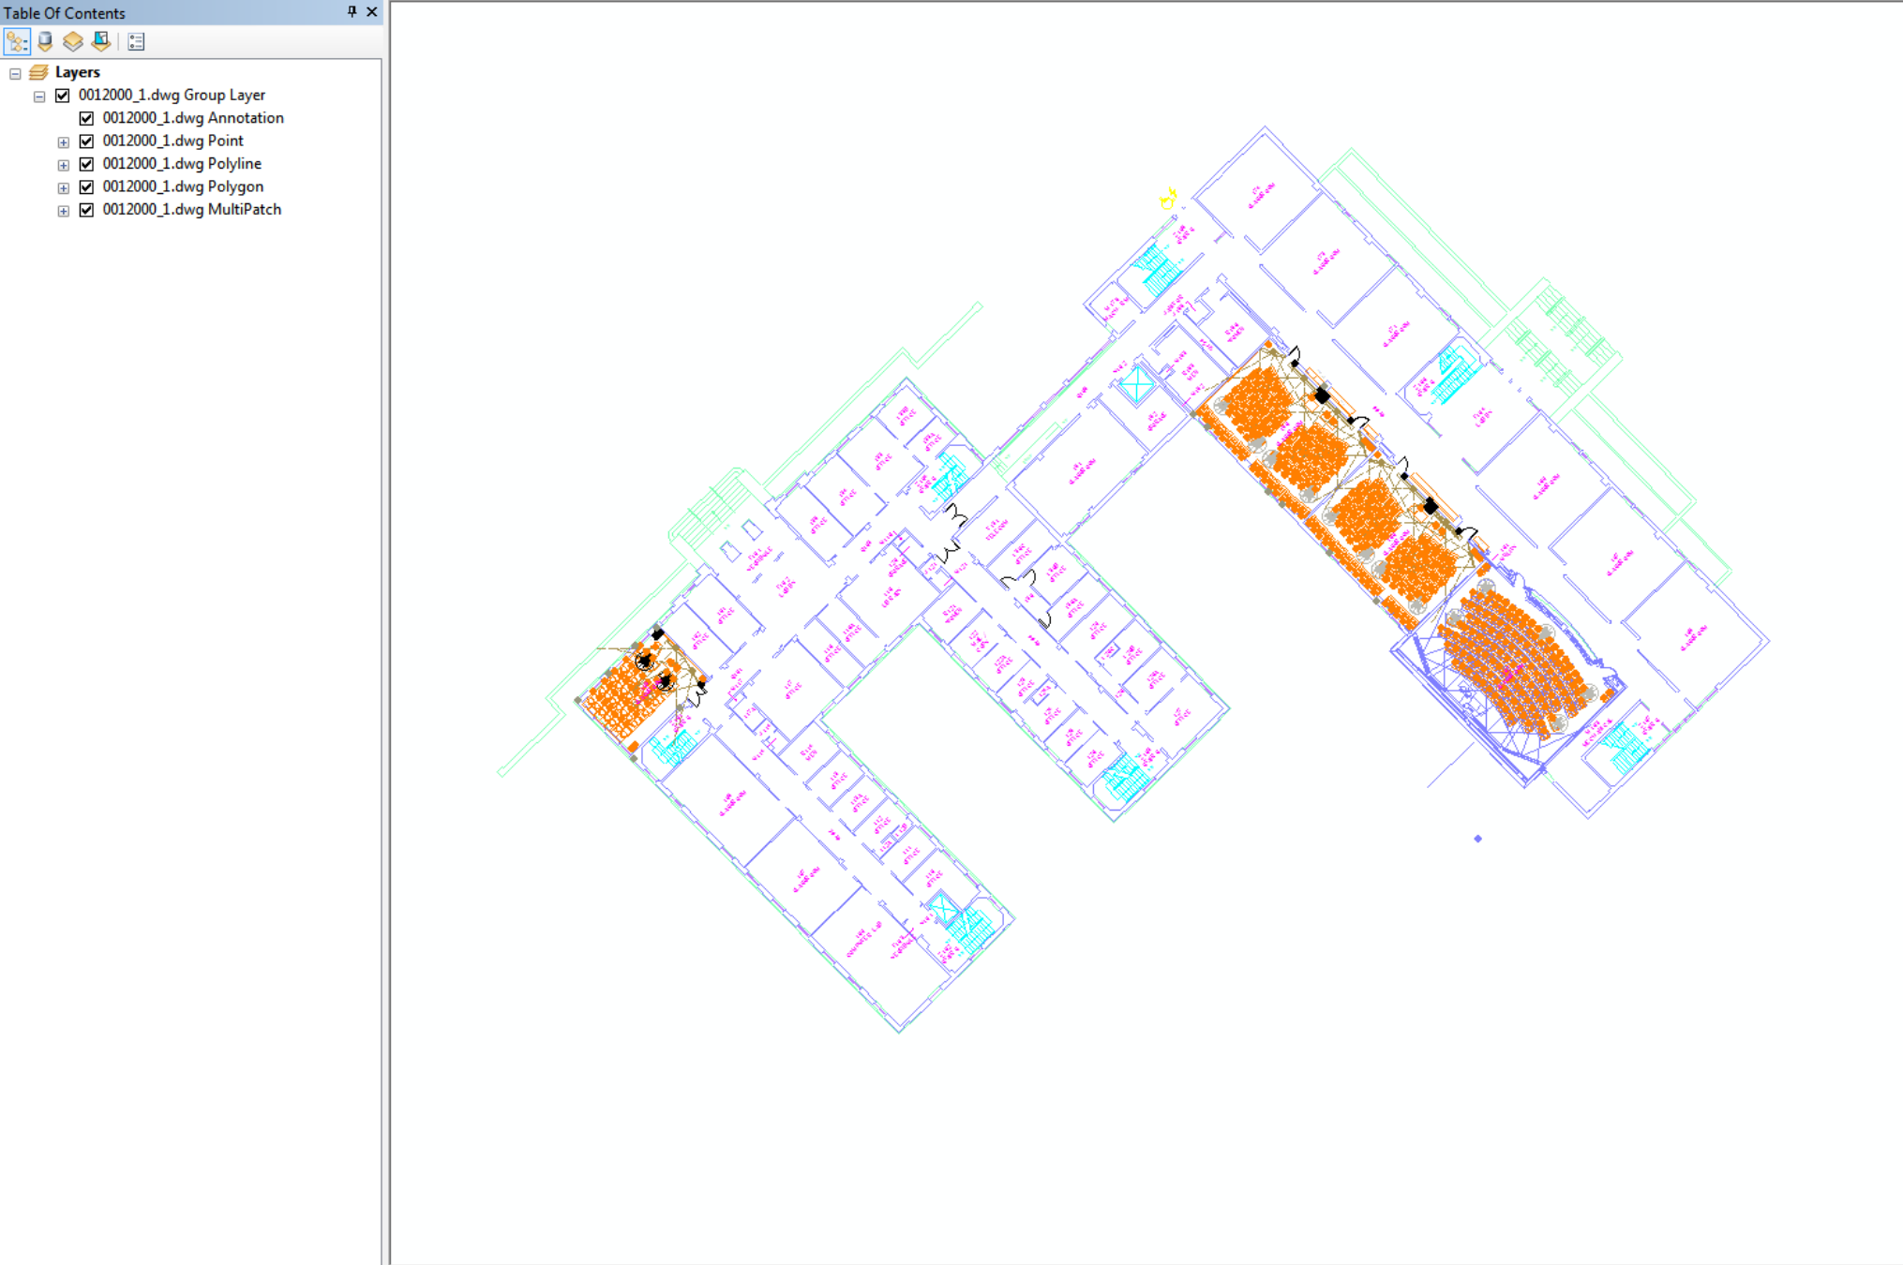

Slide 5
OPP Data - Formatting
Once the data has been brought into ArcMap the first step should be to convert the desired information into shapefile format
The polyline layer contains the information for the actual plans themselves

Slide 6
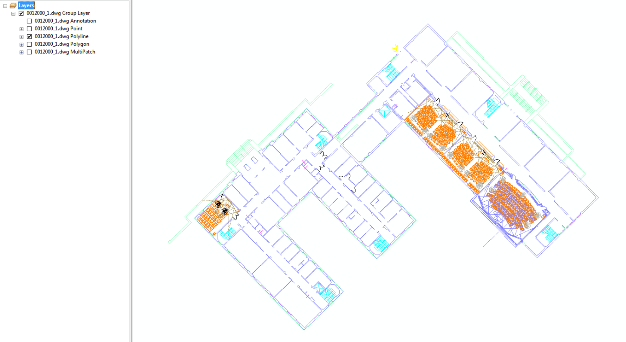

Slide 7
OPP Data - Formatting
This data can be exported to a shapefile using the Data -> Export Data feature

Slide 8
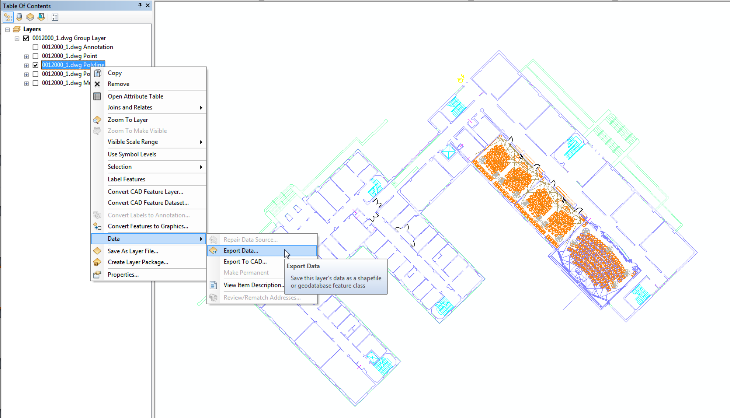

Slide 9
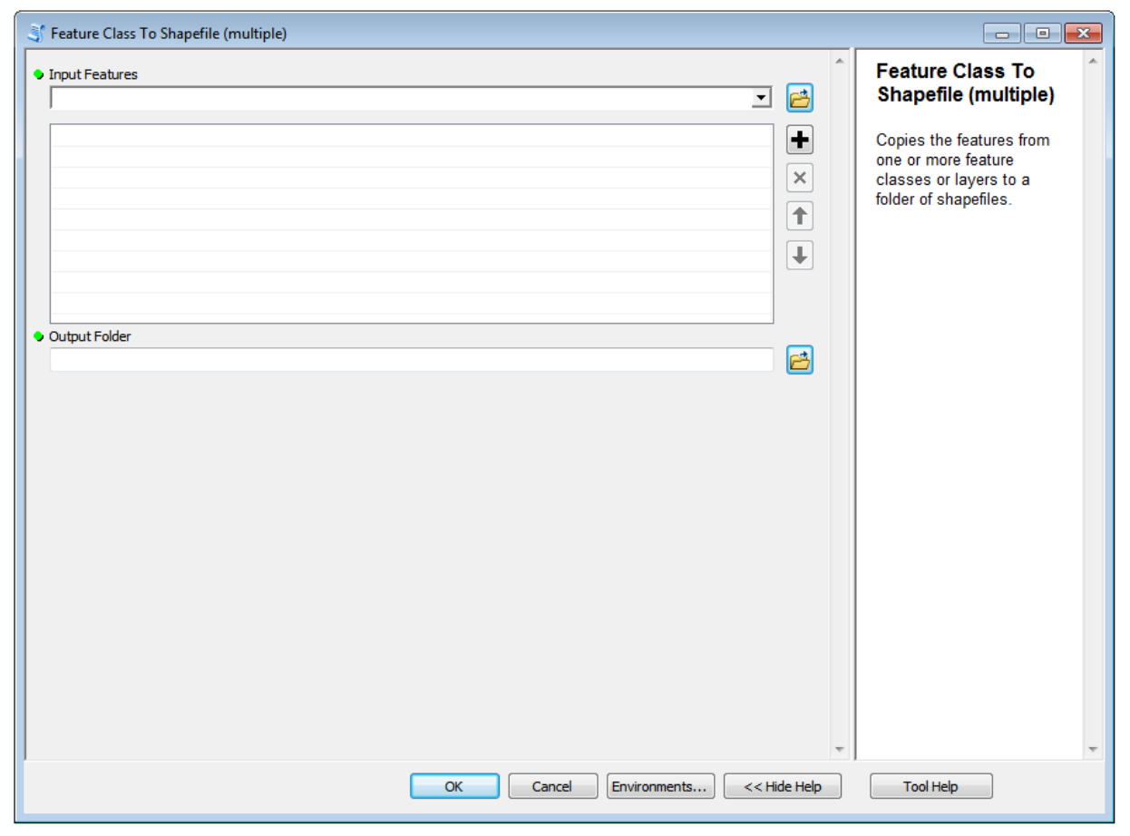
OPP Data - Formatting
The labels can also be exported to a shapefile by using the Feature Class to Shapefile tool

Slide 10
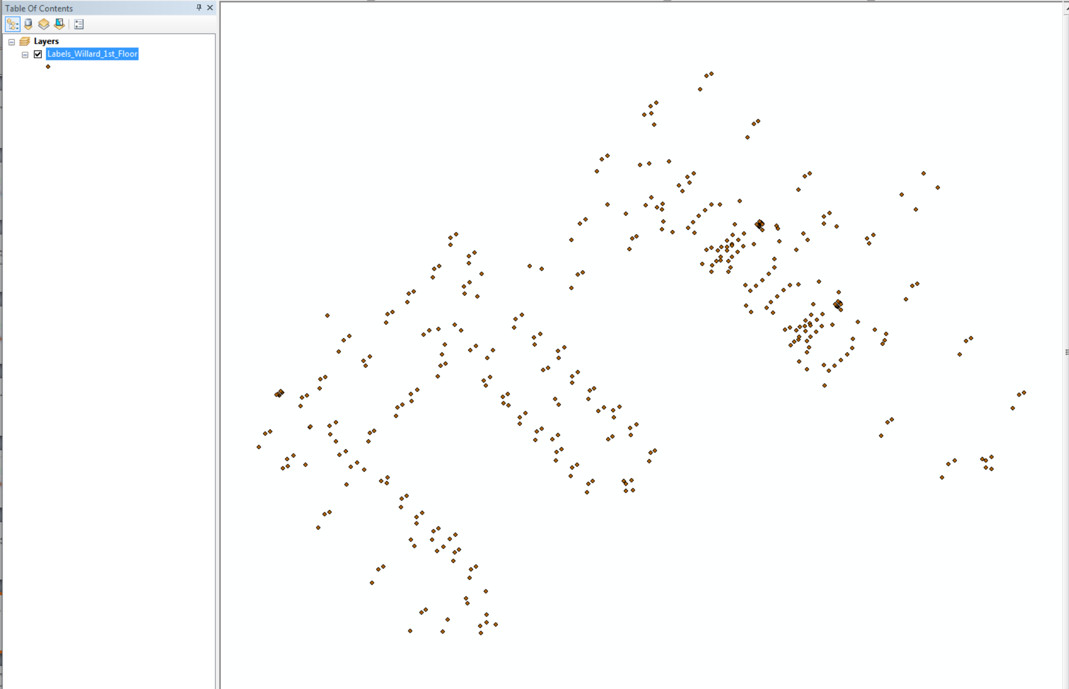
OPP Data - Formatting
This will create a point shapefile with the accurate location of the labels

Slide 11
OPP Data - Formatting
The desired information can be extracted from the attribute table of the shapefile
This is as far as I was able to get in regard to labels

Slide 12
OPP Data - Simplification
The next step is to simplify the data, so it is more visually pleasing and contains less information for the GeoJSON that it will ultimately be converted into
Ultimately I was not able to come up with a good way to do this, so your guess is as good as mine
However, it is important to note that this should be done before a coordinate system is defined

Slide 13
OPP Data – Coordinate Systems
When the data is originally brought into ArcMap it does not have a coordinate system. Therefore, a coordinate system must be defined
The “Define Projection” tool under the Data Management toolbox is the best way to do this
NAD 1983 State Plane Pennsylvania North FIPS 3701 (Feet) is the correct coordinate system

Slide 14
OPP Data – Coordinate Systems
However, this is not the final coordinate system
Interactive online maps are in the WGS 1984 coordinate system, so all data must be re-projected to this coordinate system
This is best done by defining the coordinate system for the layer as WGS 1984, and then exporting the data using the same coordinate system as the data frame

Slide 15
OPP Data – Coordinate Systems
The units for NAD 1983 State Plane Pennsylvania North FIPS 3701 (Feet) are feet (obviously), while the units for WGS 1984 are decimal degrees
This can be used as a check to make sure the data is in the correct coordinate system

Slide 16
OPP Data – GeoJSON
The next step is to convert the shapefile into a GeoJSON (Java Script Object Notation)
Although this can theoretically be done through ArcGIS or QGIS, I had the most success using the website http://ogre.adc4gis.com

Slide 17
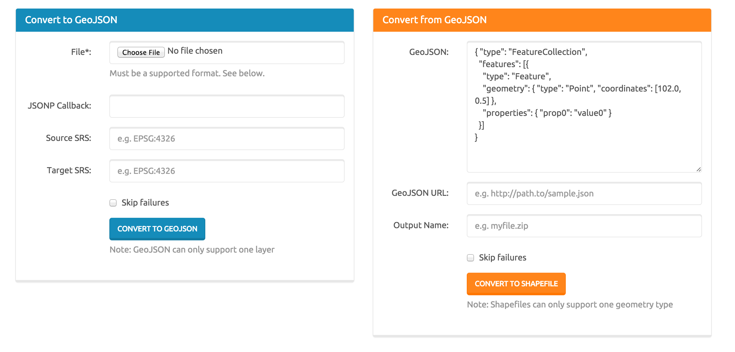

Slide 18
OPP Data – GeoJSON
The result of the tool is a text file that contains the GeoJSON information
The website http://geojson.io can be used to see if the information is accurate

Slide 19
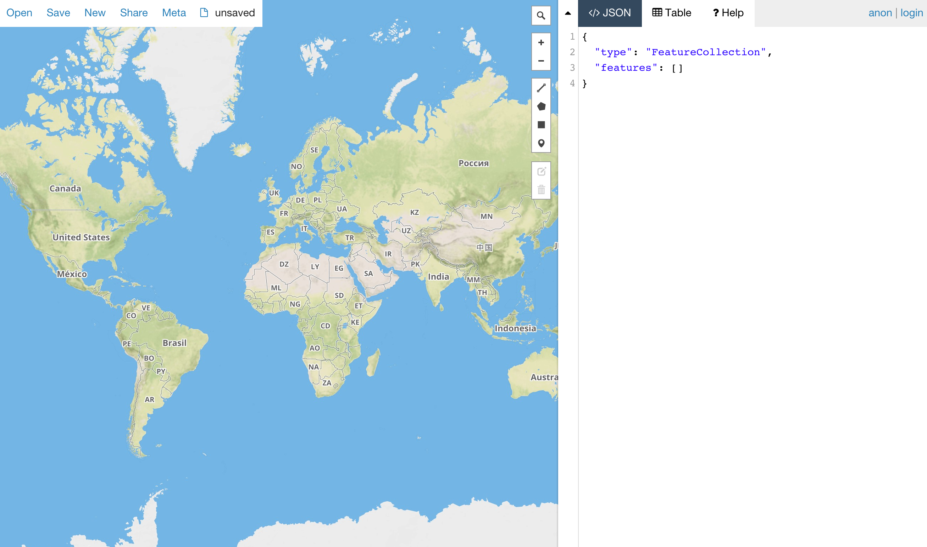

Slide 20
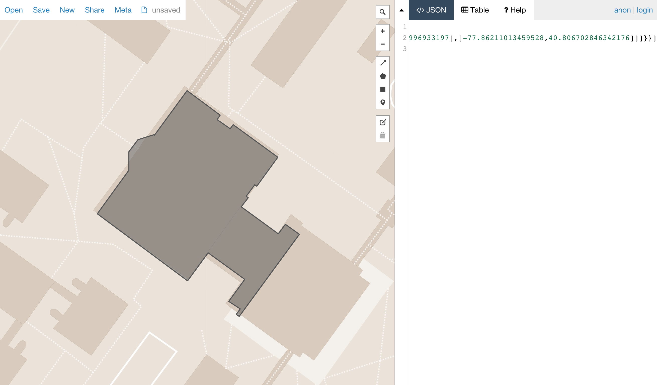

Slide 21
OPP Data – GitHub
The next step is to upload the GeoJSON to GitHub
This is done by defining a repository and then a branch and then a folder
For more information ask Aaron

Slide 22
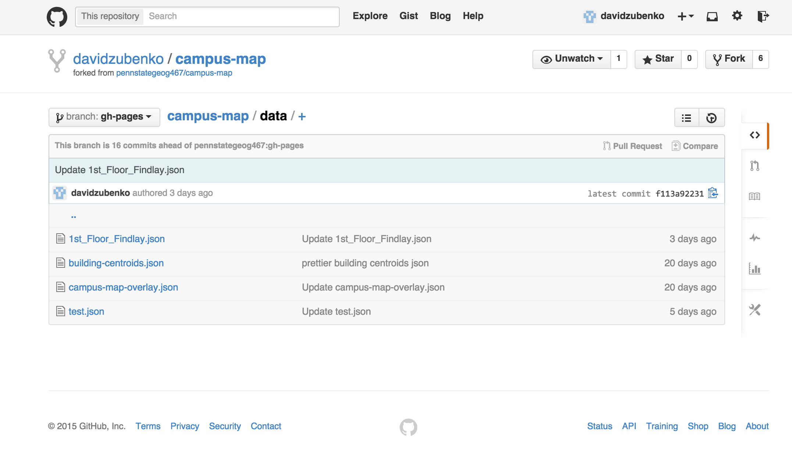

Slide 23
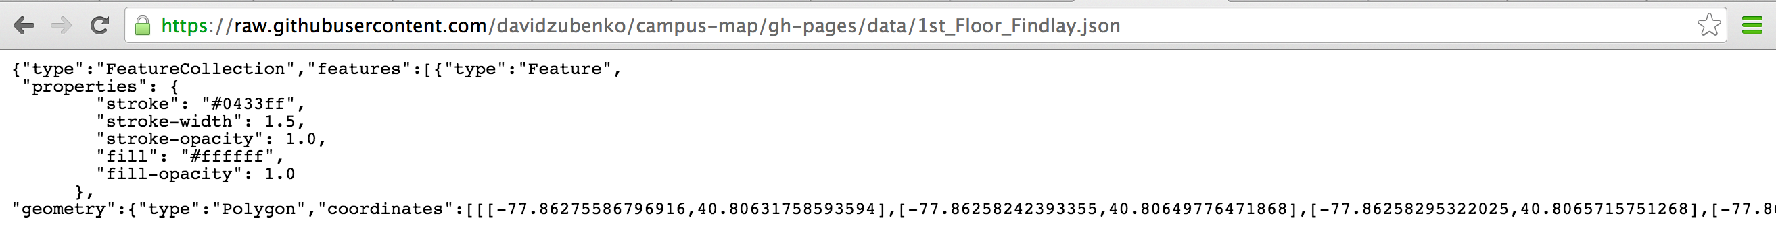
OPP Data – GitHub
Each file has a “raw” feature, including a url

Slide 24
OPP Data – GitHub
This url is then put into the converter at www.rawgit.com

Slide 25
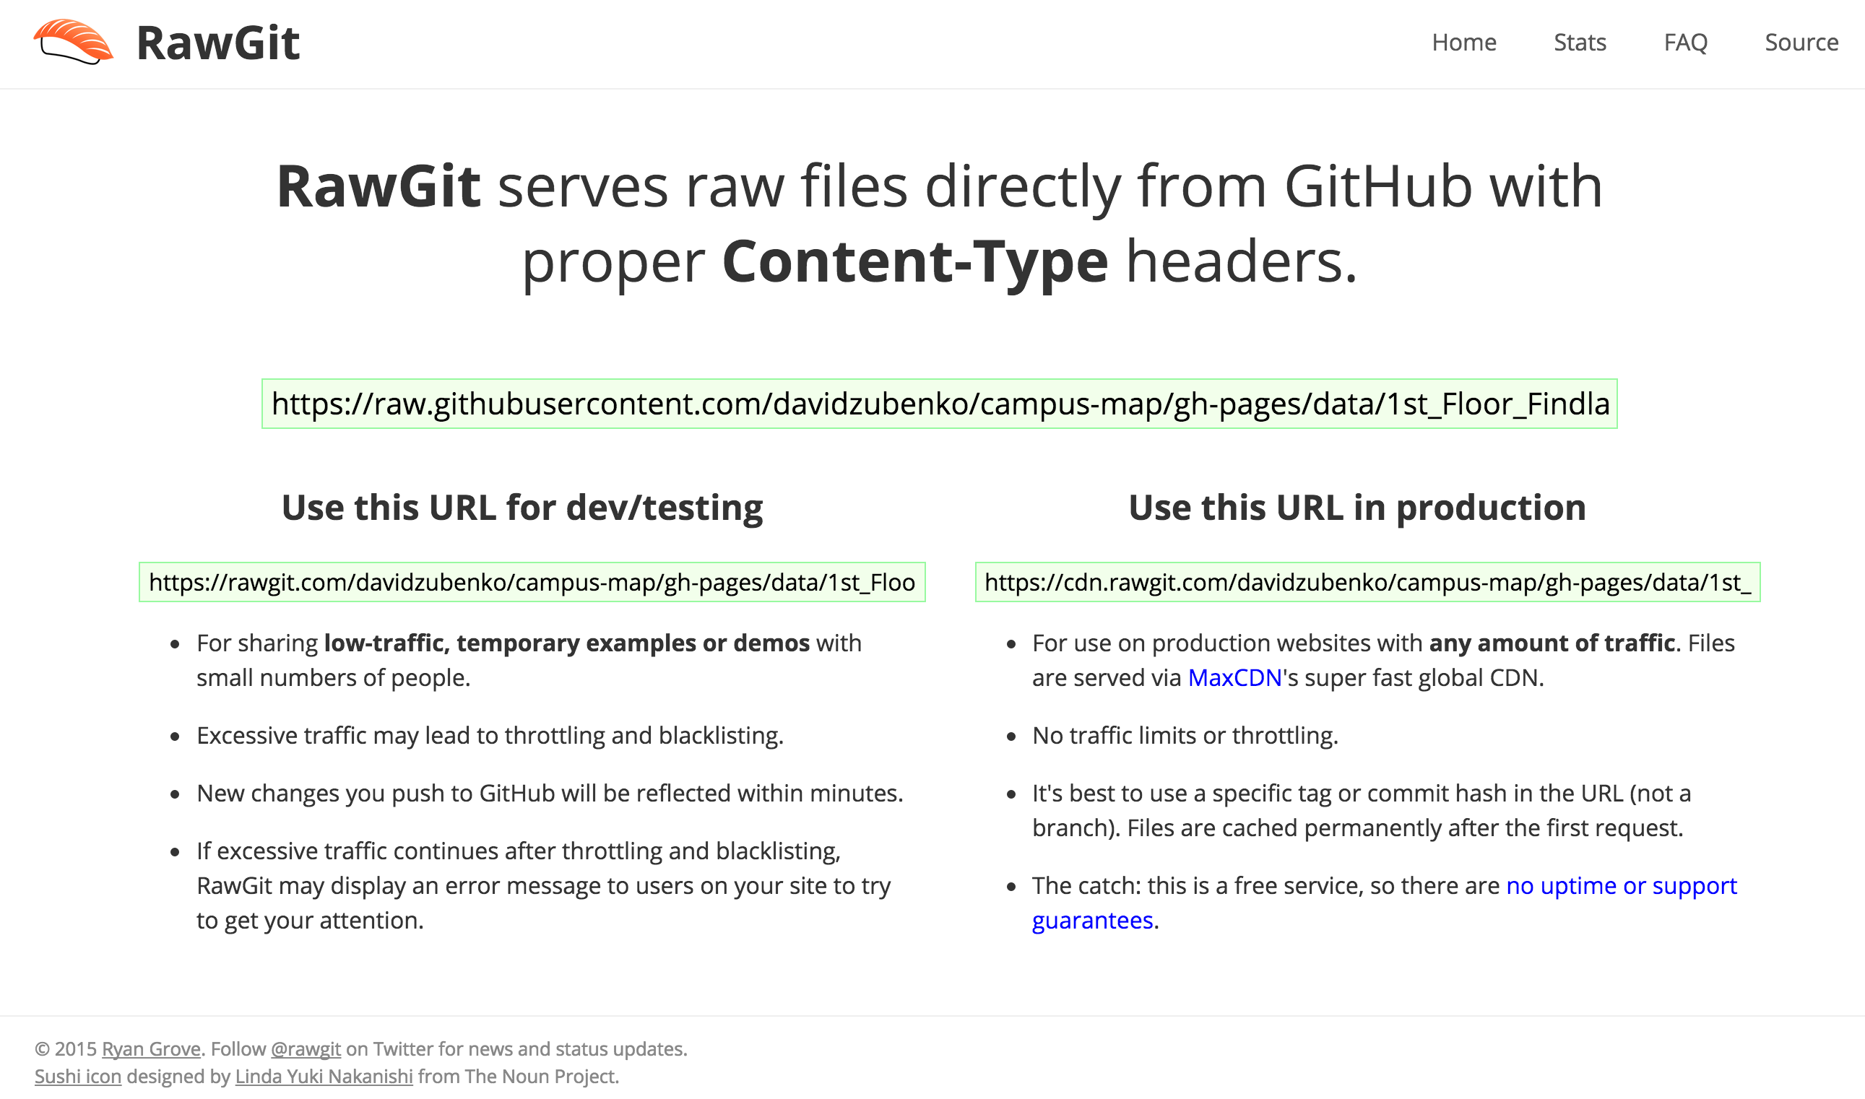

Slide 26
OPP Data – JSFiddle
The new url can be added to the campus map on JSFiddle

Slide 27
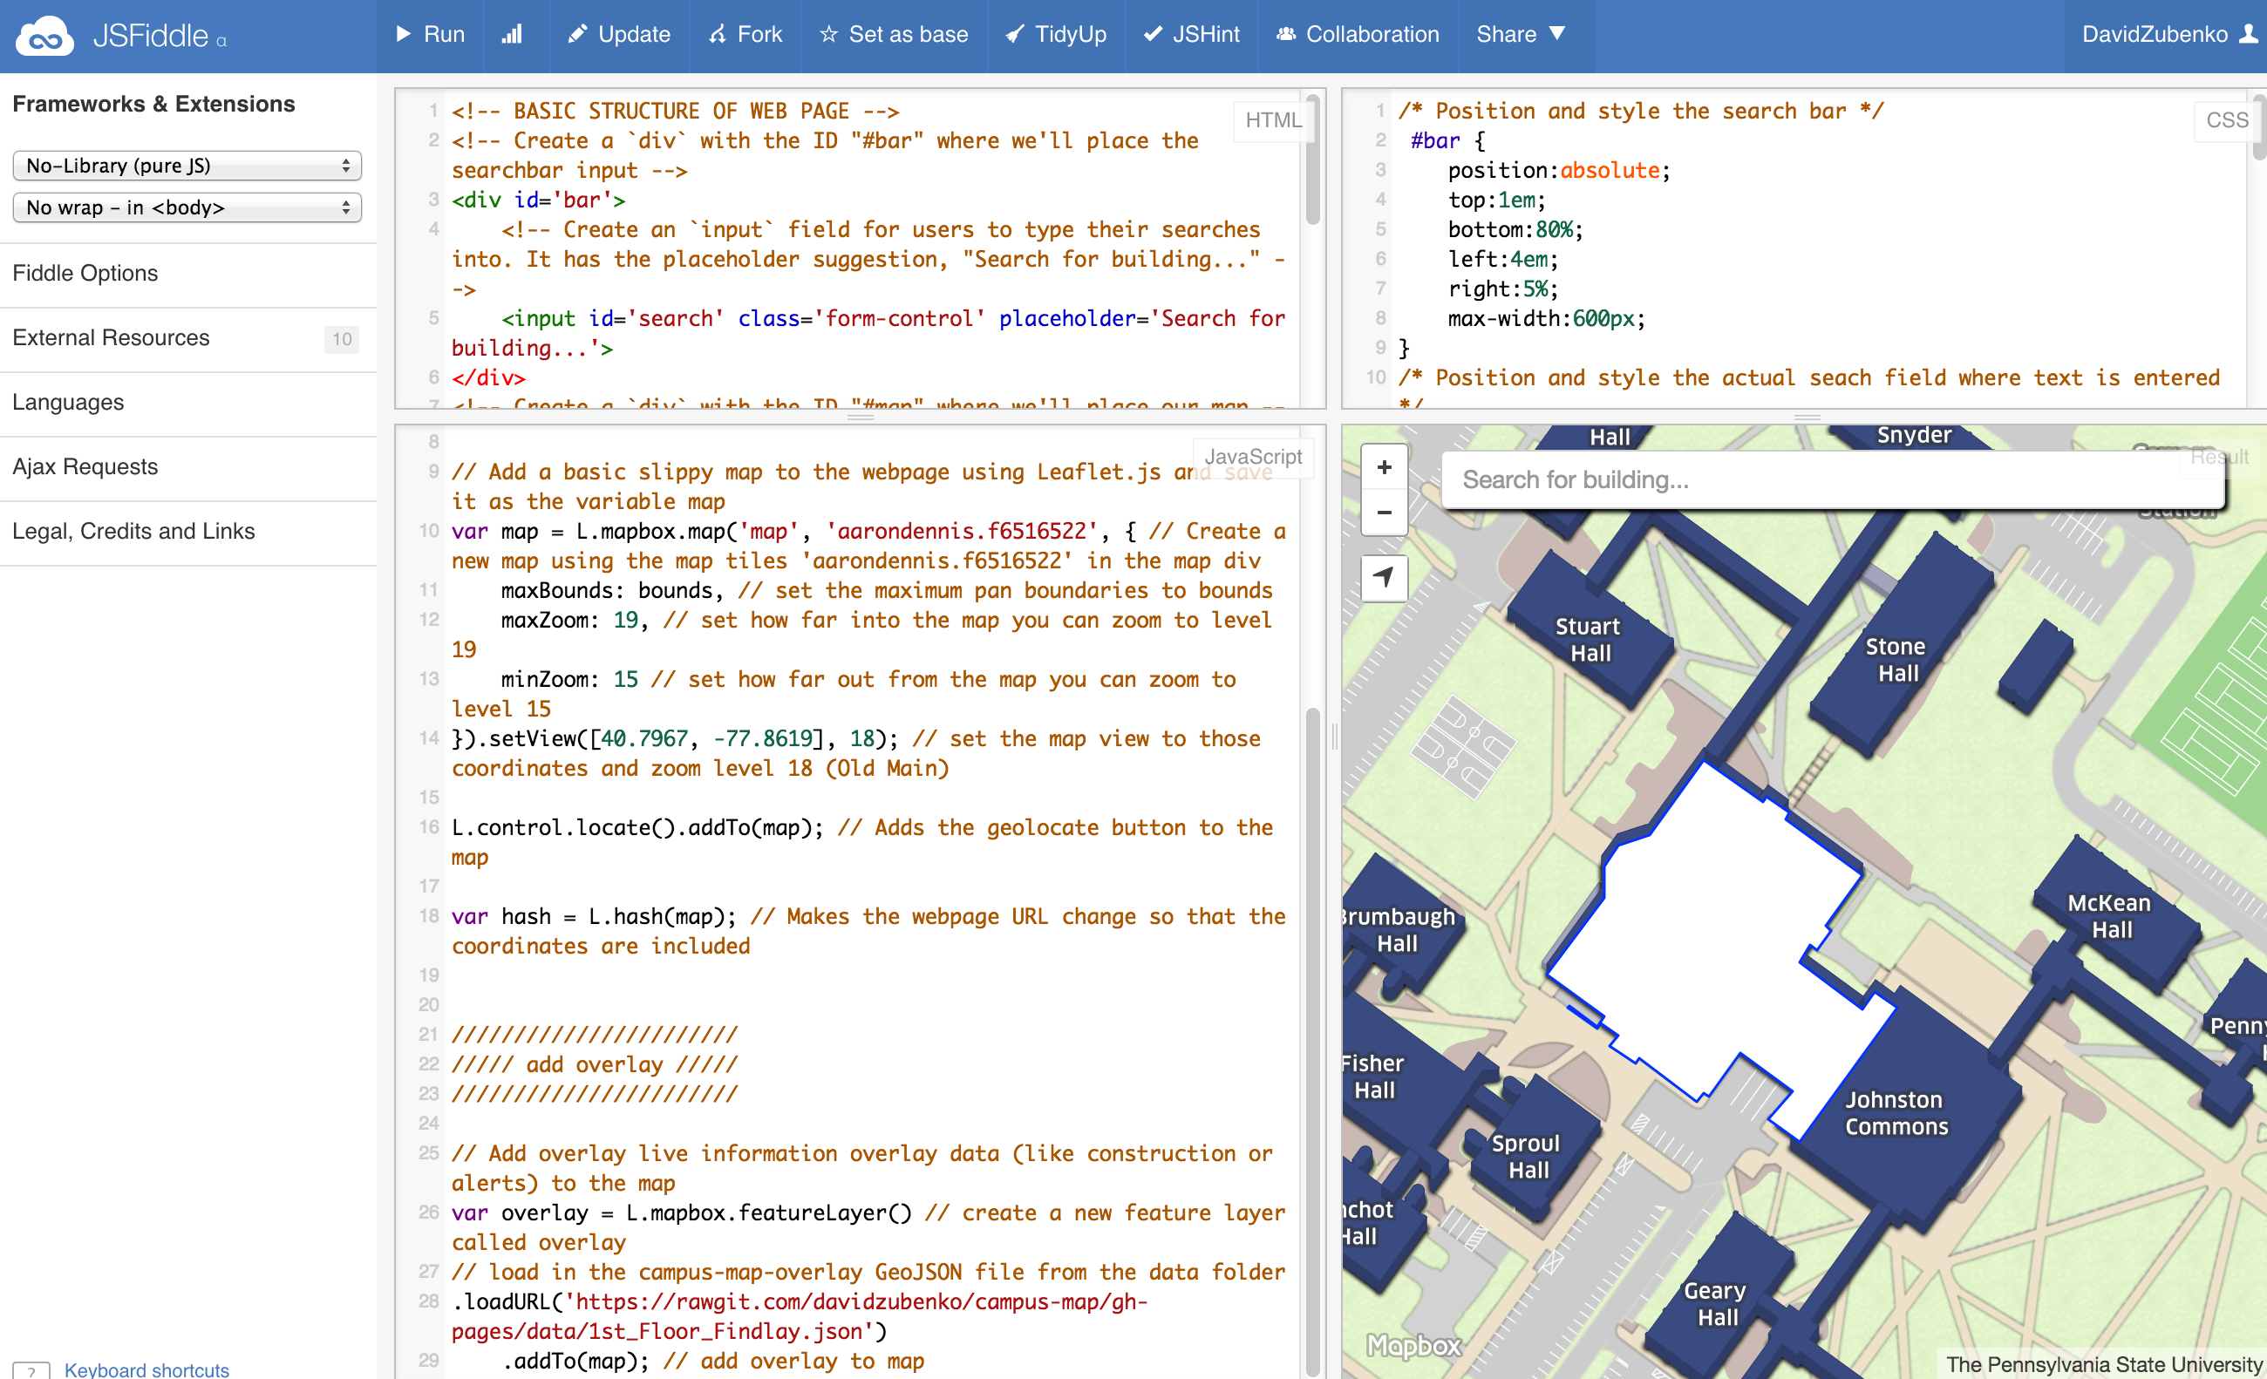

Slide 28
OPP Data
This is as far as I was able to get

Slide 29
Google Indoor Maps
Another possible solution is Google Indoor Maps
This is a service Google has that allows individuals to upload floor plans that are then added to Google Maps
This service can be used for public spaces only

Slide 30
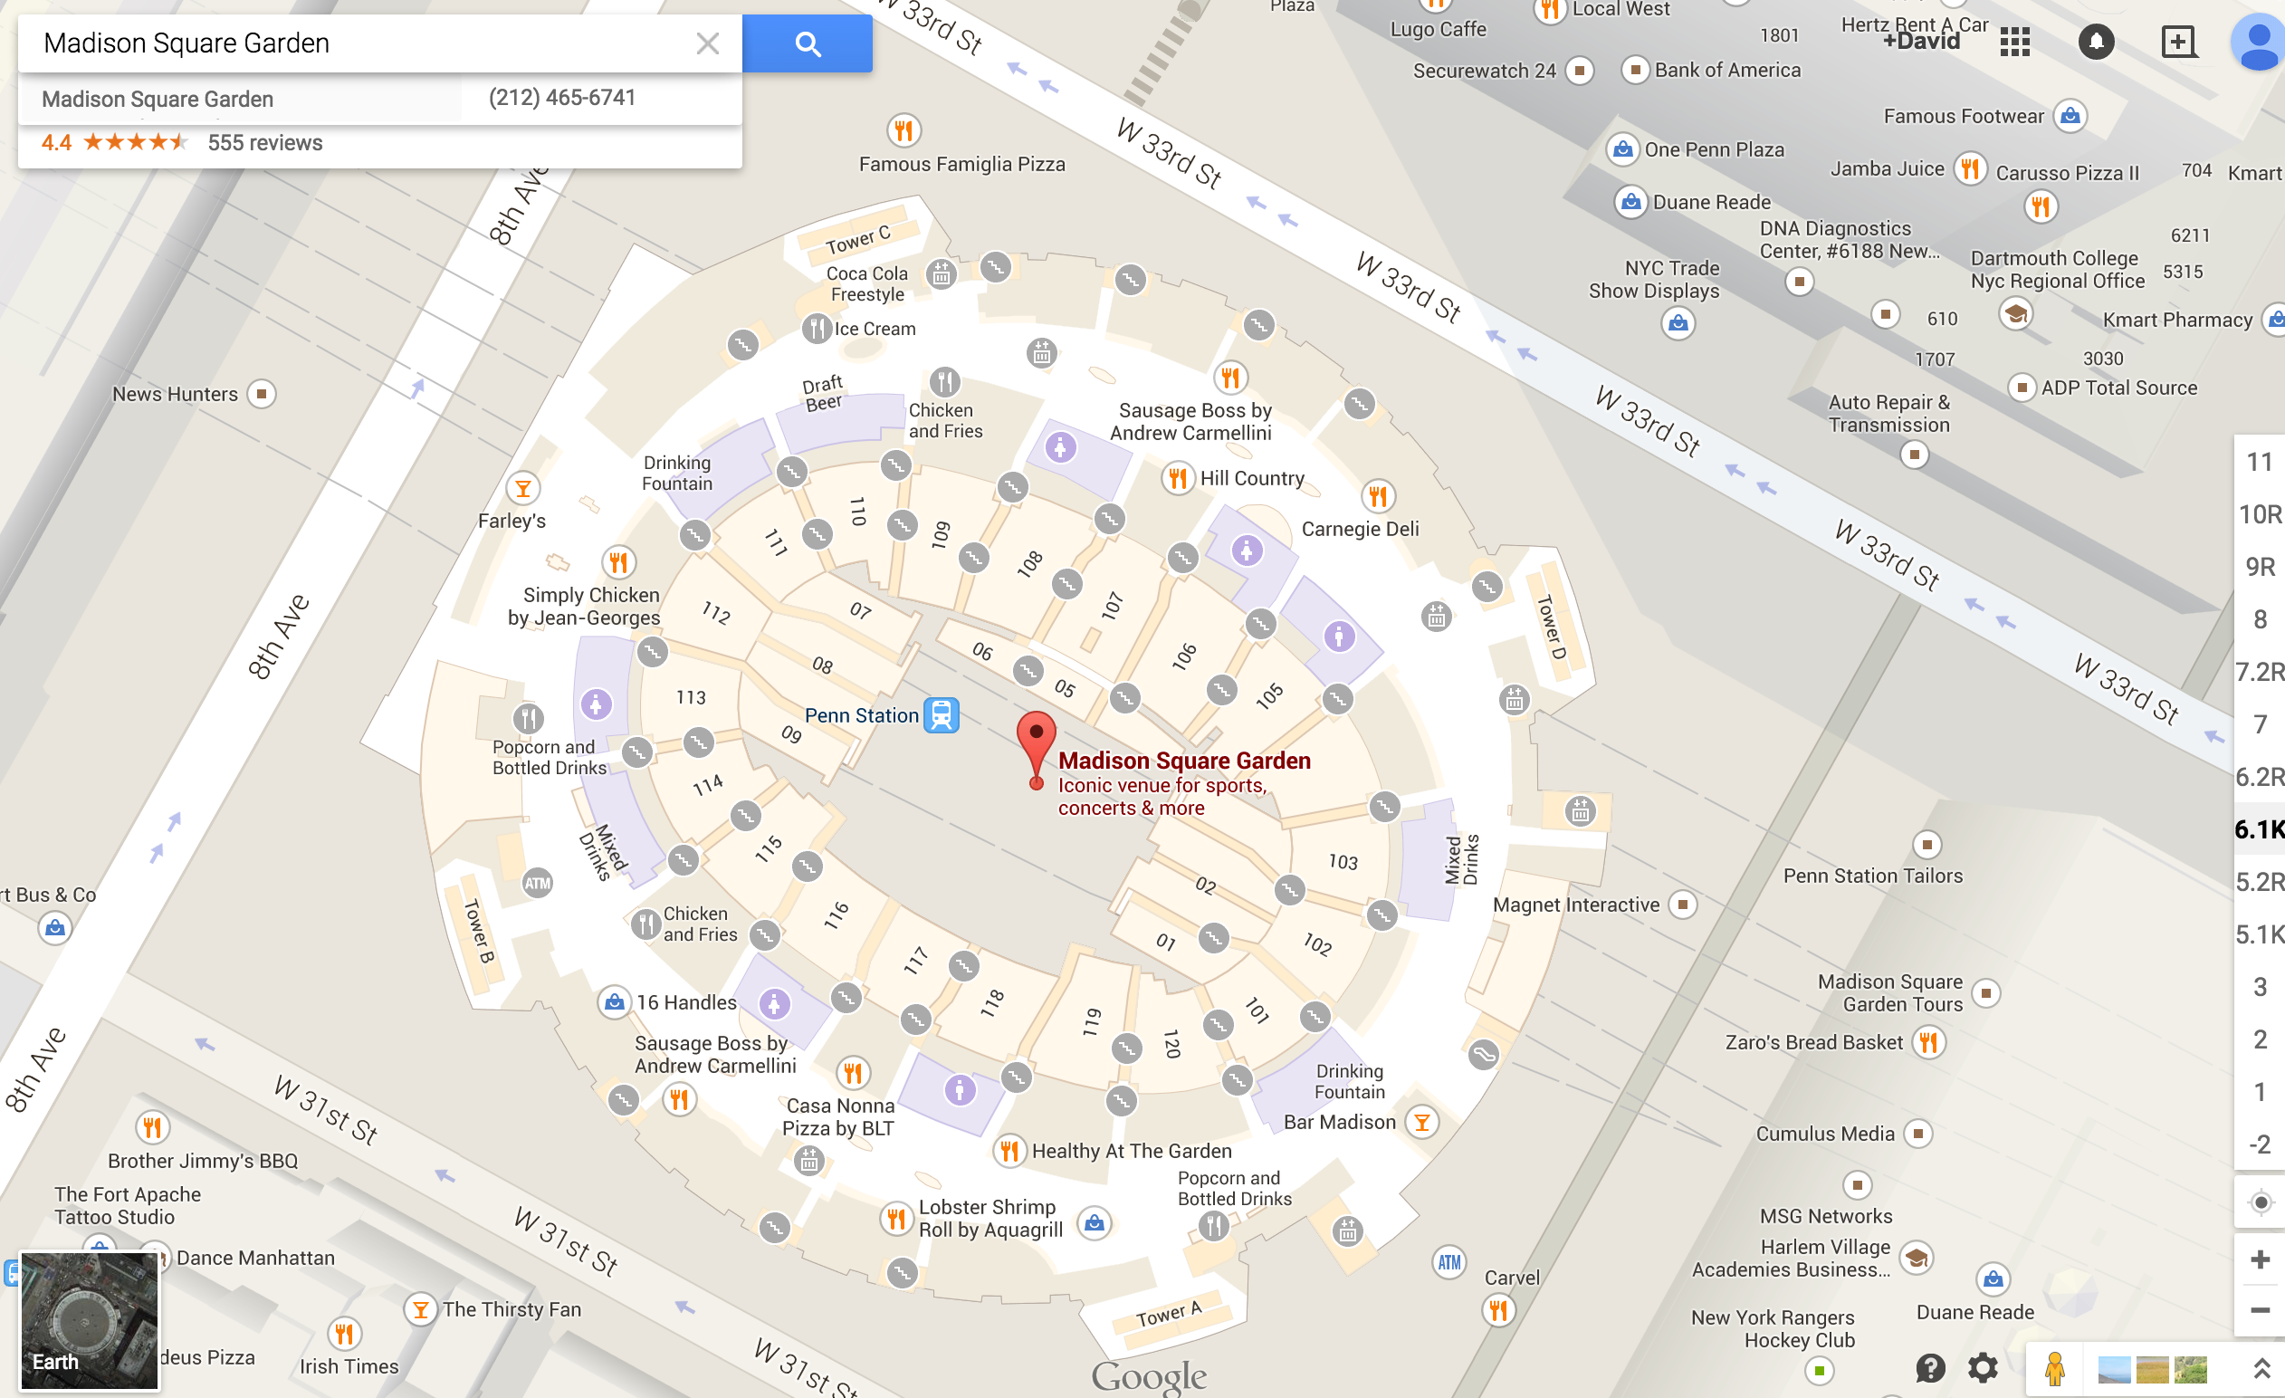

Slide 31
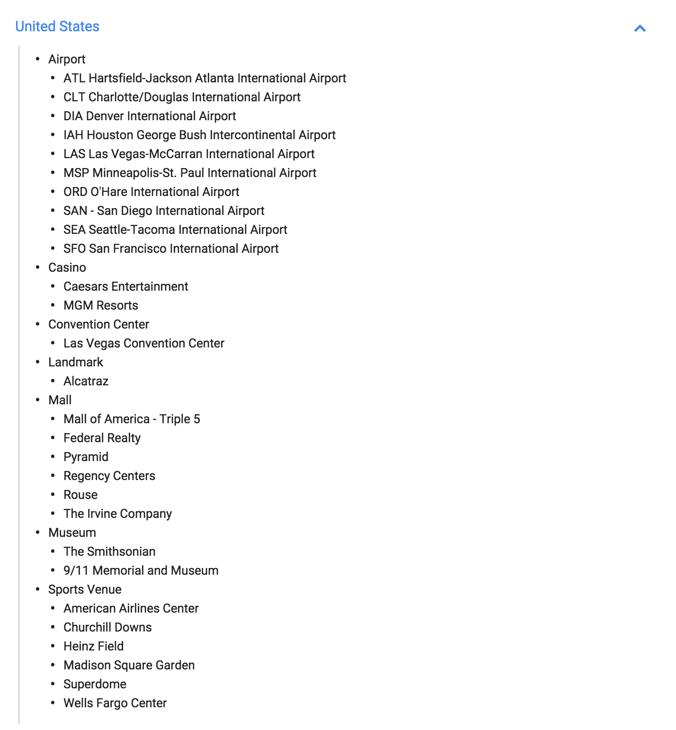

Slide 32
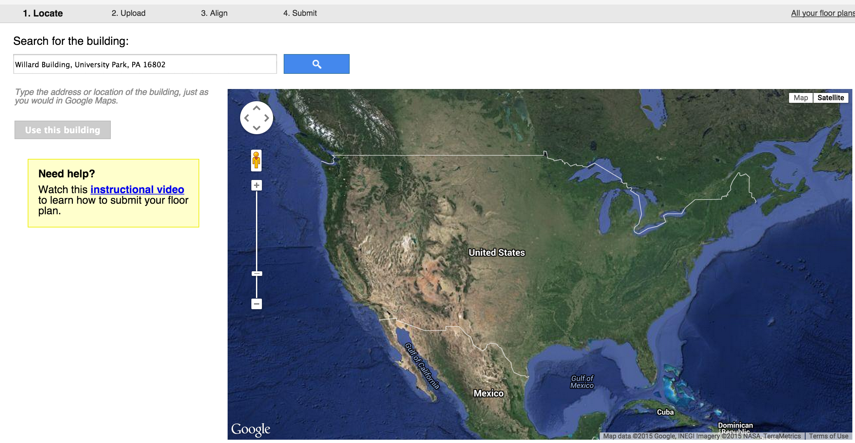

Slide 33
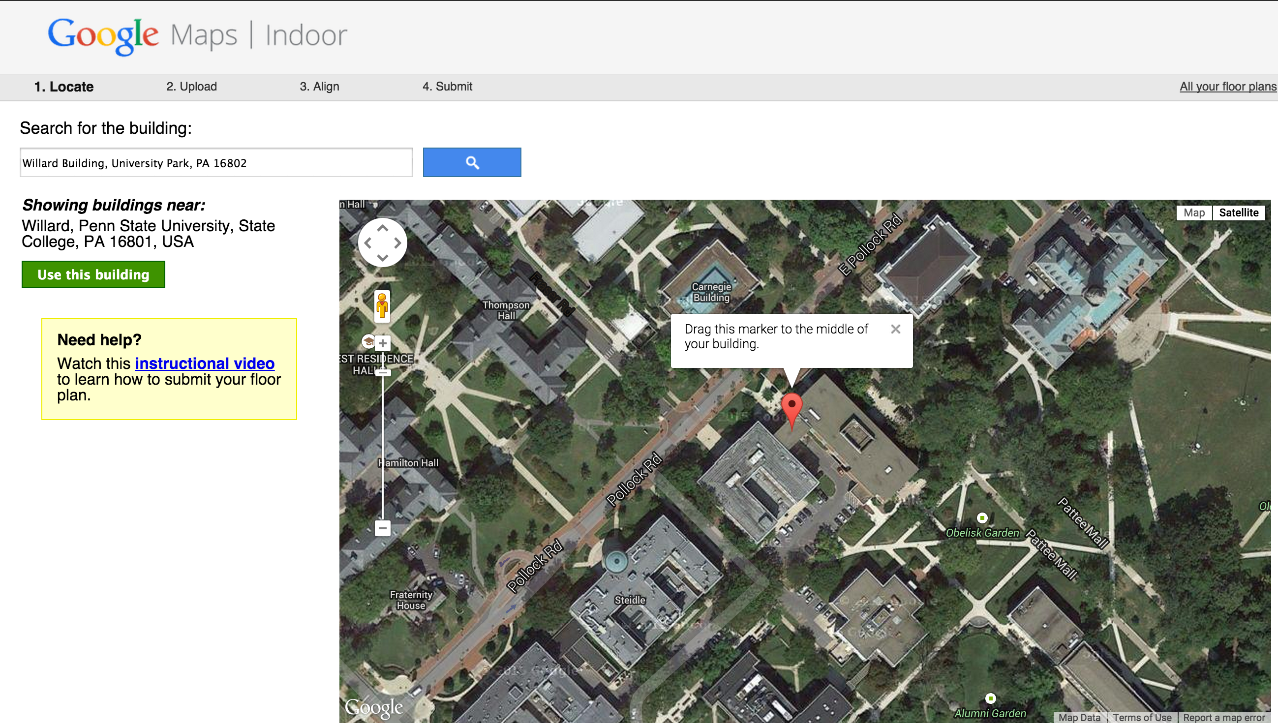

Slide 34
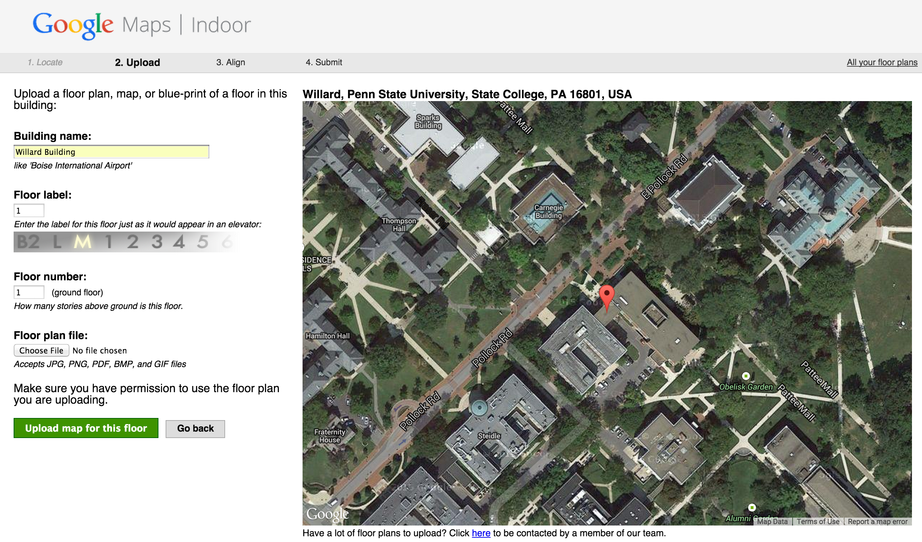

Slide 35
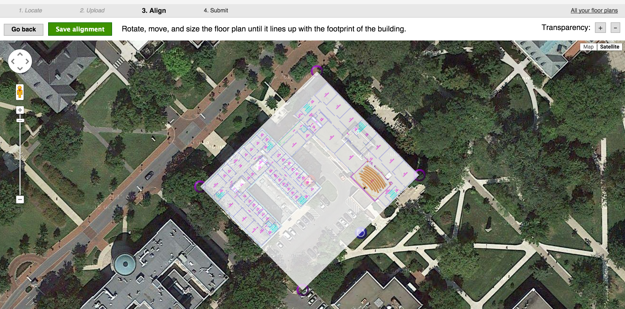

Slide 36
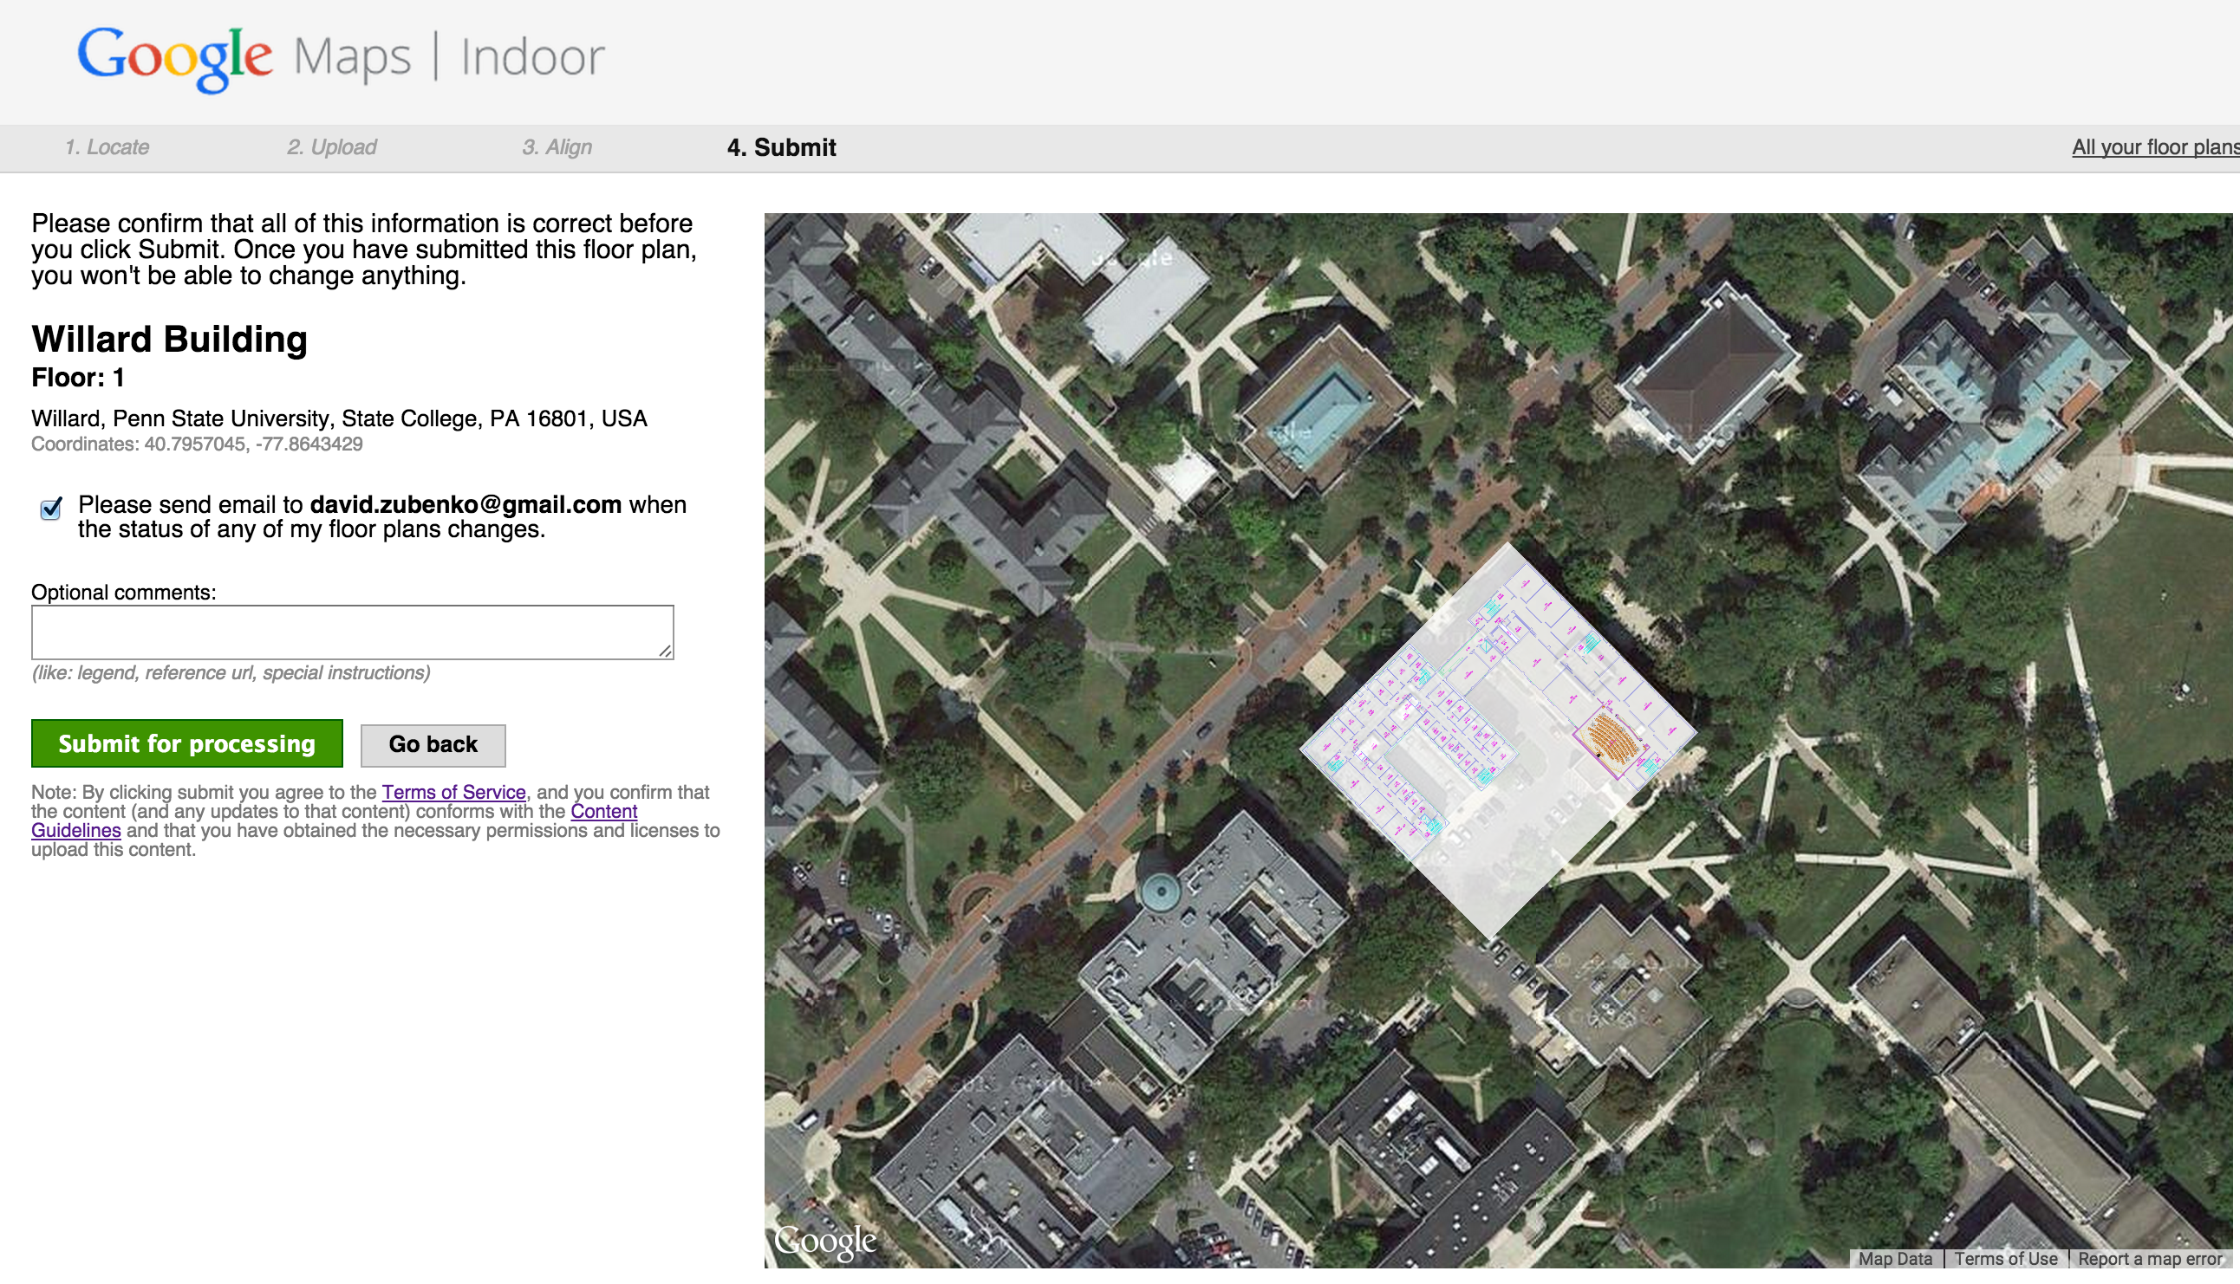

Slide 37
The End

